Slide 1

Exploring the Nutritional Information at Starbucks
By: Adriana Pinto

Slide 2
What the Dataset Covers
Beverage category
Beverage
Beverage prep
Calories
Total Fat (g)
Trans Fat (g
Saturated Fat (g)
Sodium (mg)
Total Carbohydrates (g)
Dietary Fiber (g)
Sugars (g)
Protein
Vitamin A
Vitamin C
Calcium
Iron
Caffeine (mg

Slide 3
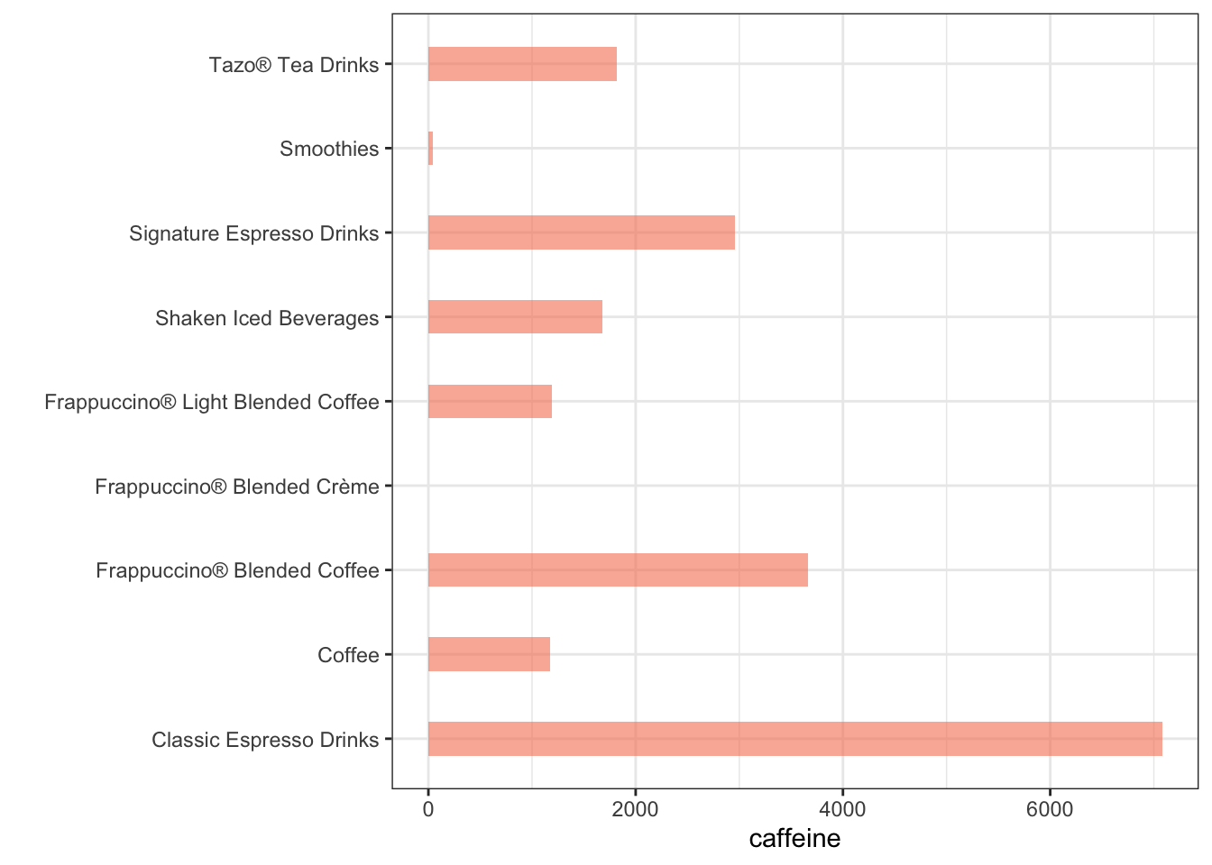
Caffeine
Correlation of beverage types to caffeine
3 Moat Caffeinated Beverages
caffeine | Beverage | Size
410 | Brewed Coffee | Venti
330 | Brewed Coffee | Grande
300 | Caffè Americano | Venti

Slide 4
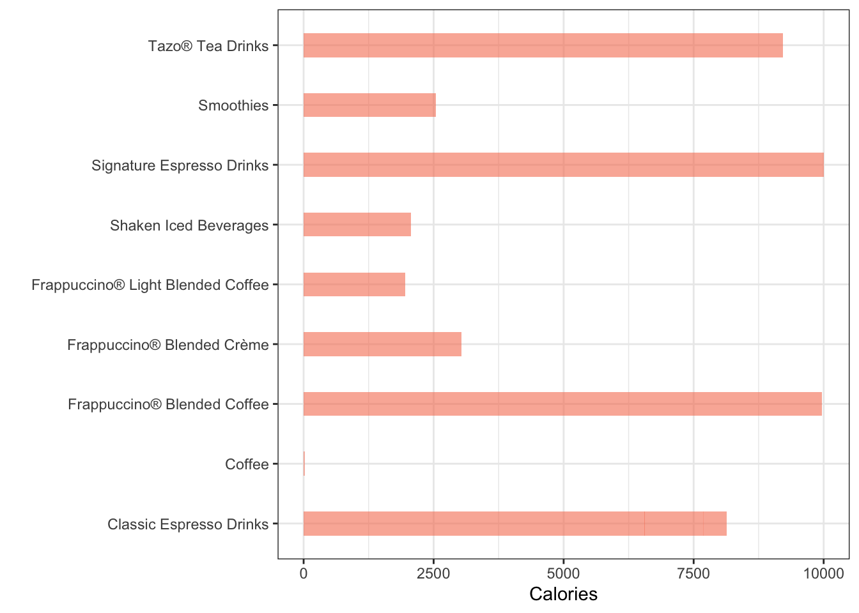
Calories
10 Highest Calorie Drinks
Beverage | Beverage_prep | Calories
1 | White Chocolate Mocha (Without Whipped Cream) | 2% Milk | 510
2 | White Chocolate Mocha (Without Whipped Cream) | Soymilk | 460
3 | Java Chip (Without Whipped Cream) | Whole Milk | 460
4 | White Chocolate Mocha (Without Whipped Cream) | Venti Nonfat Milk | 450
5 | Tazo® Green Tea Latte | 2% Milk | 450
6 | Java Chip (Without Whipped Cream) | Soymilk | 430
7 | Java Chip (Without Whipped Cream) | Venti Nonfat Milk | 420
8 | White Chocolate Mocha (Without Whipped Cream) | 2% Milk | 400
9 | Tazo® Green Tea Latte | Soymilk | 390
10 | Mocha (Without Whipped Cream) | Whole Milk | 390

Slide 5
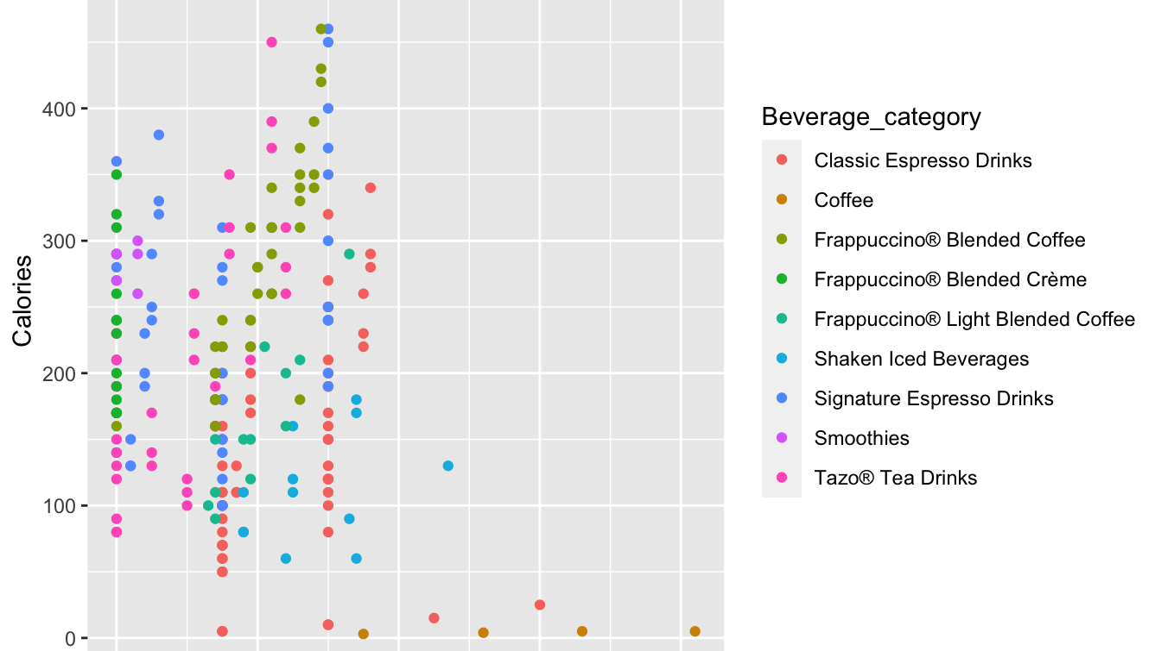
Correlation of Caffeine and Calories

Slide 6
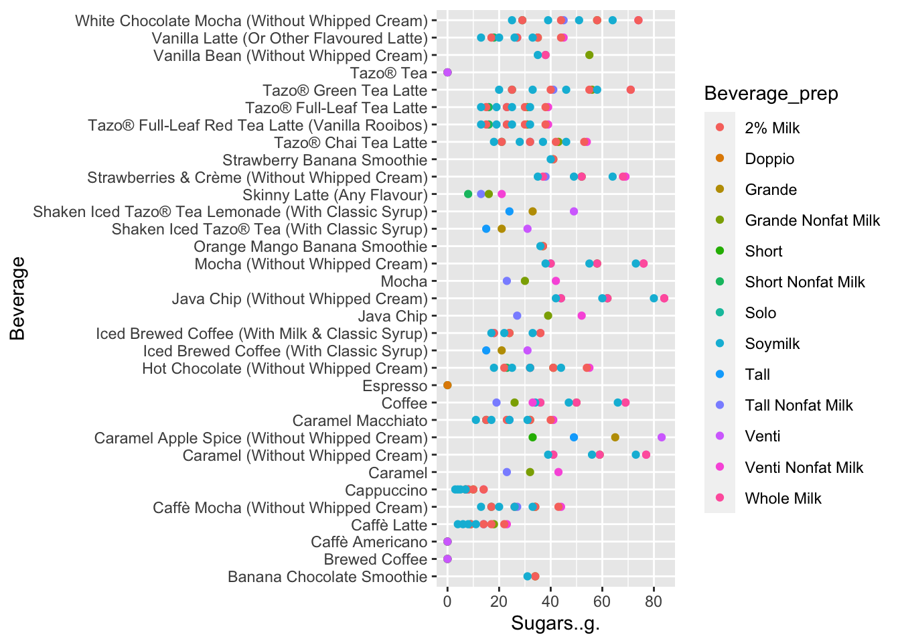
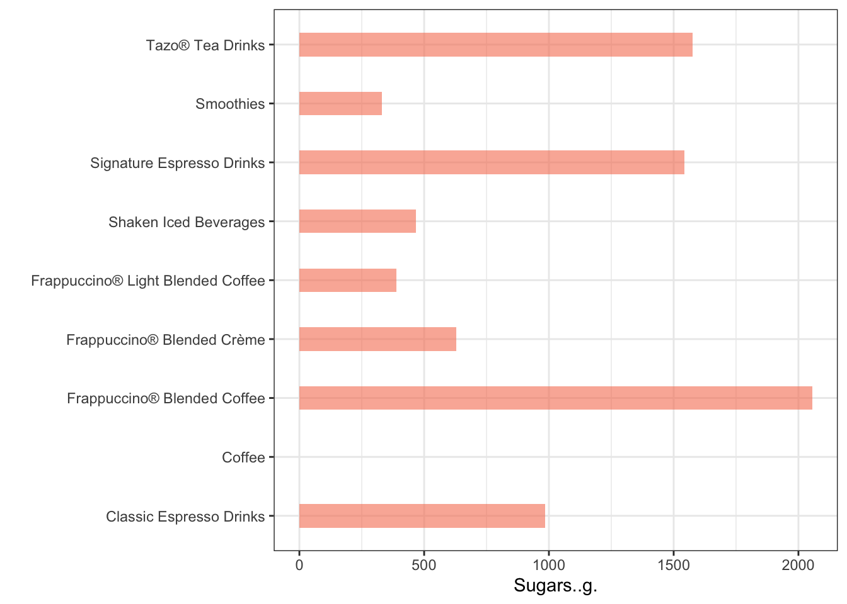
Sugar

Slide 7
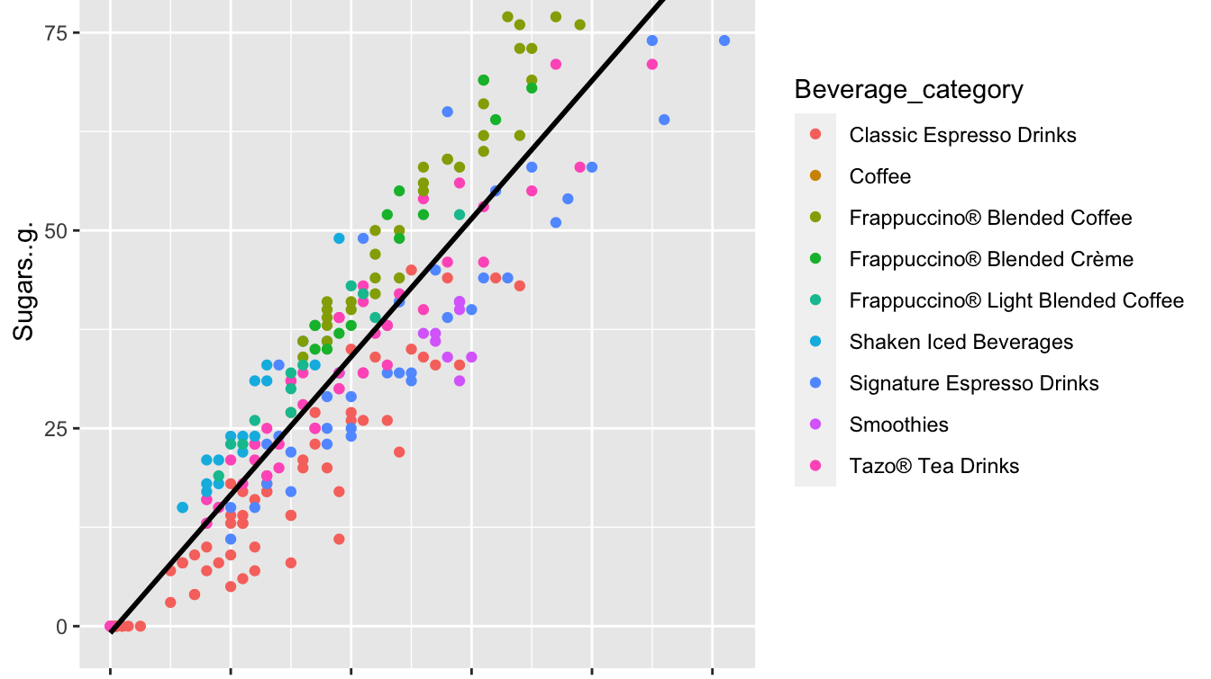
Correlation of Sugar and Calories

Slide 8
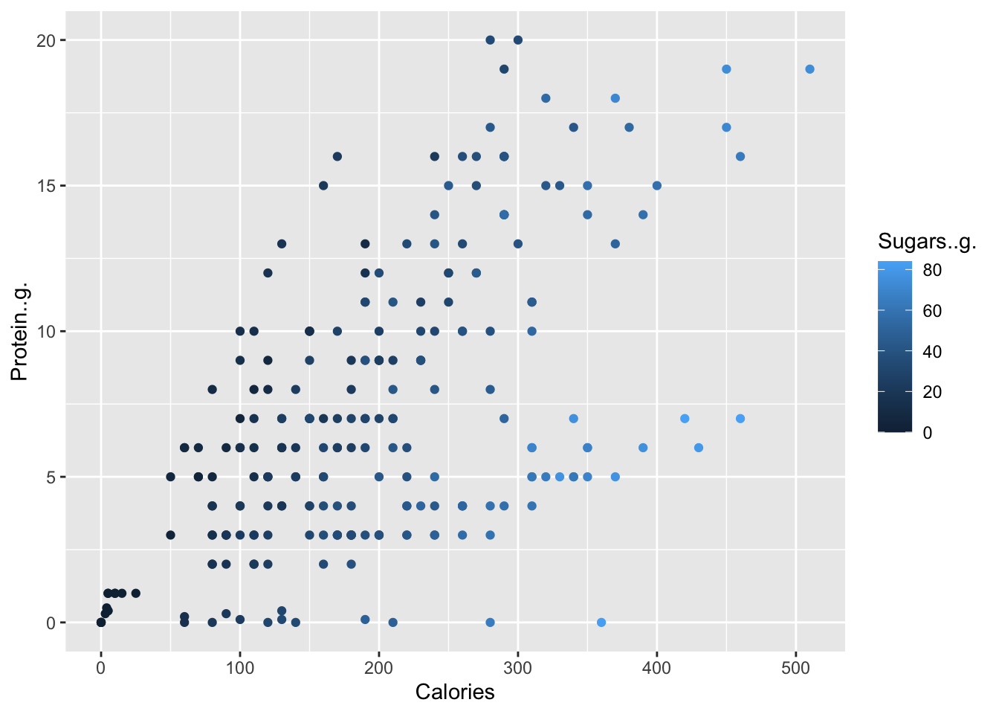
Protein
Beverage_category | Beverage | Protein..g.
Smoothies | Banana Chocolate Smoothie | 20.0
Smoothies | Banana Chocolate Smoothie | 20.0
Signature Espresso Drinks | White Chocolate Mocha (Without Whipped Cream) | 19.0
Signature Espresso Drinks | White Chocolate Mocha (Without Whipped Cream) | 19.0
Smoothies | Banana Chocolate Smoothie | 19.0

Slide 9
Carbs
Lowest Carb Options
 | Beverage | Type | Carbs
 | Espresso | Solo | 0
 | Tazo® Tea | Short | 0
 | Tazo® Tea | Tall | 0
 | Tazo® Tea | Grande | 0
 | Tazo® Tea | Venti | 0
 | Shaken Iced Tazo® Tea (With Classic Syrup) | Tall | 0
 | Shaken Iced Tazo® Tea (With Classic Syrup) | Grande | 0
 | Shaken Iced Tazo® Tea (With Classic Syrup) | Venti | 0
 | Shaken Iced Tazo® Tea Lemonade (With Classic Syrup) | Tall | 0
 | Shaken Iced Tazo® Tea Lemonade (With Classic Syrup) | Grande | 0
Highest Carb options
 | Beverage | Type | Carbs
 | Java Chip (Without Whipped Cream) | Venti Nonfat Milk | 340
 | Java Chip (Without Whipped Cream) | Whole Milk | 340
 | White Chocolate Mocha (Without Whipped Cream) | 2% Milk | 330
 | Java Chip (Without Whipped Cream) | Soymilk | 330
 | Java Chip | Venti Nonfat Milk | 320

